Slide 1
Bernoulli Distribution Geometric Distribution
Dr. John S. Butler

Slide 2
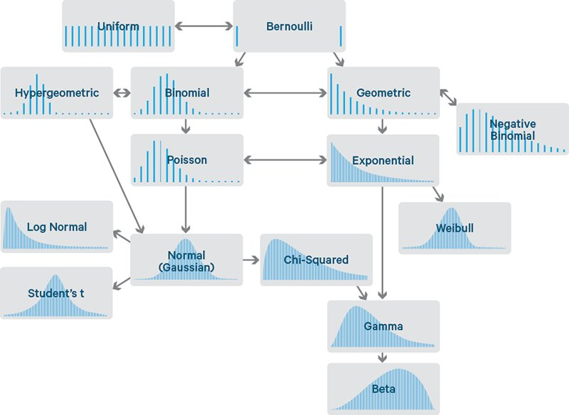
Bernoulli Distribution

Slide 3
Bernoulli Distribution
A Bernoulli trial generates one of two possible outcomes – “success” or “failure”
Define the Random Variable
X=1 if a success
X= 0 if a failure
The Random Variable is termed a Bernoulli RV with the Bernoulli probability distribution

Slide 4
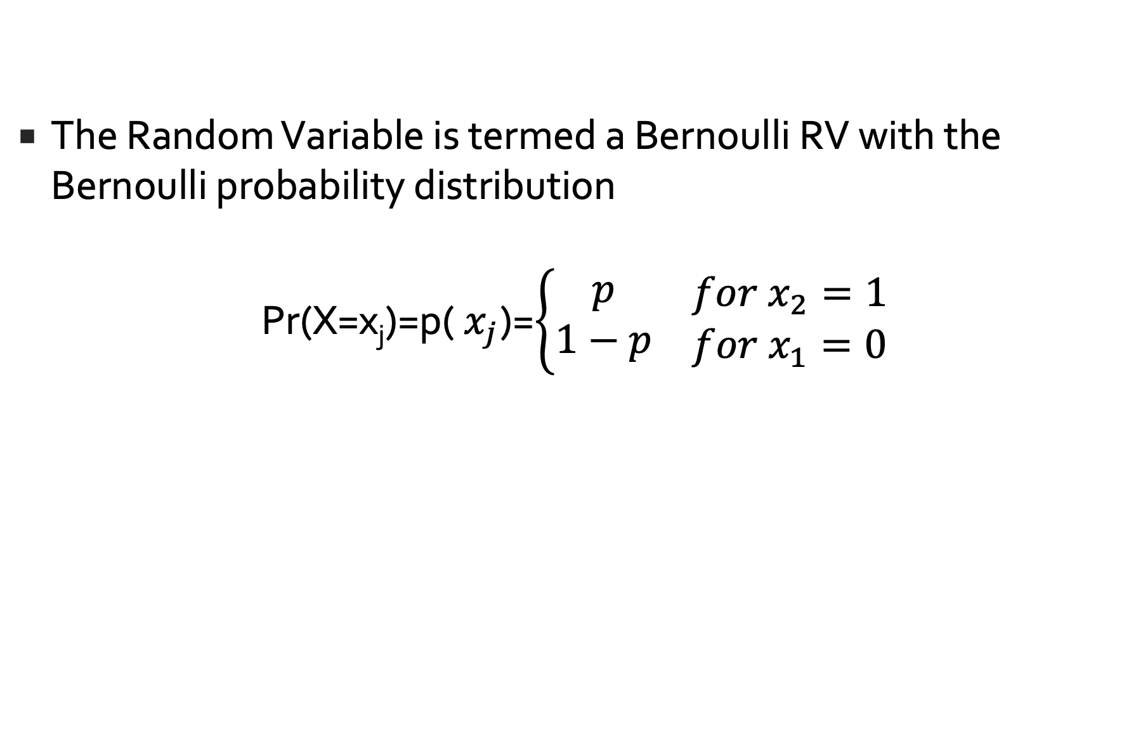
Bernoulli Distribution
The Random Variable is termed a Bernoulli RV with the Bernoulli probability distribution
Pr(X=x_{j})=p(${ x}_{j}$)=$\left\{\begin{matrix}p \\ 1−p\end{matrix}\begin{matrix} \\ \end{matrix}\begin{matrix}for x_{2}=1 \\ for{ x}_{1}=0\end{matrix}\right.$
i | 1 | 2
x_{i} | 0 | 1
P(x_{i}) | 1-p=q | p

Slide 5
Bernoulli Distribution
From this we can show that
E[X]=p
Var[X]=pq
Proof?

Slide 6
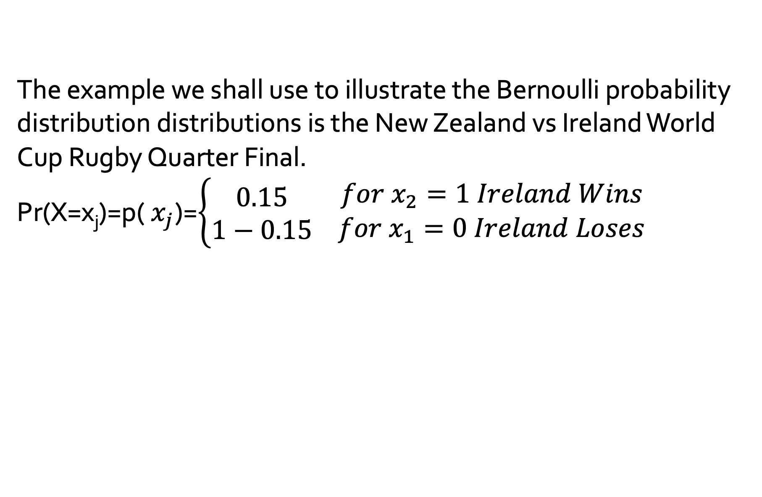
Example Bernoulli Distribution
The example we shall use to illustrate the Bernoulli probability distribution distributions is the New Zealand vs Ireland World Cup Rugby Quarter Final.
Pr(X=x_{j})=p(${ x}_{j}$)=$\left\{\begin{matrix}0.15 \\ 1−0.15\end{matrix}\begin{matrix} \\ \end{matrix}\begin{matrix}for x_{2}=1 Ireland Wins \\ for{ x}_{1}=0 Ireland Loses\end{matrix}\right.$
i | 1 | 2
x_{i} | 0 | 1
P(x_{i}) | 1-0.15=0.85 | 0.15

Slide 7
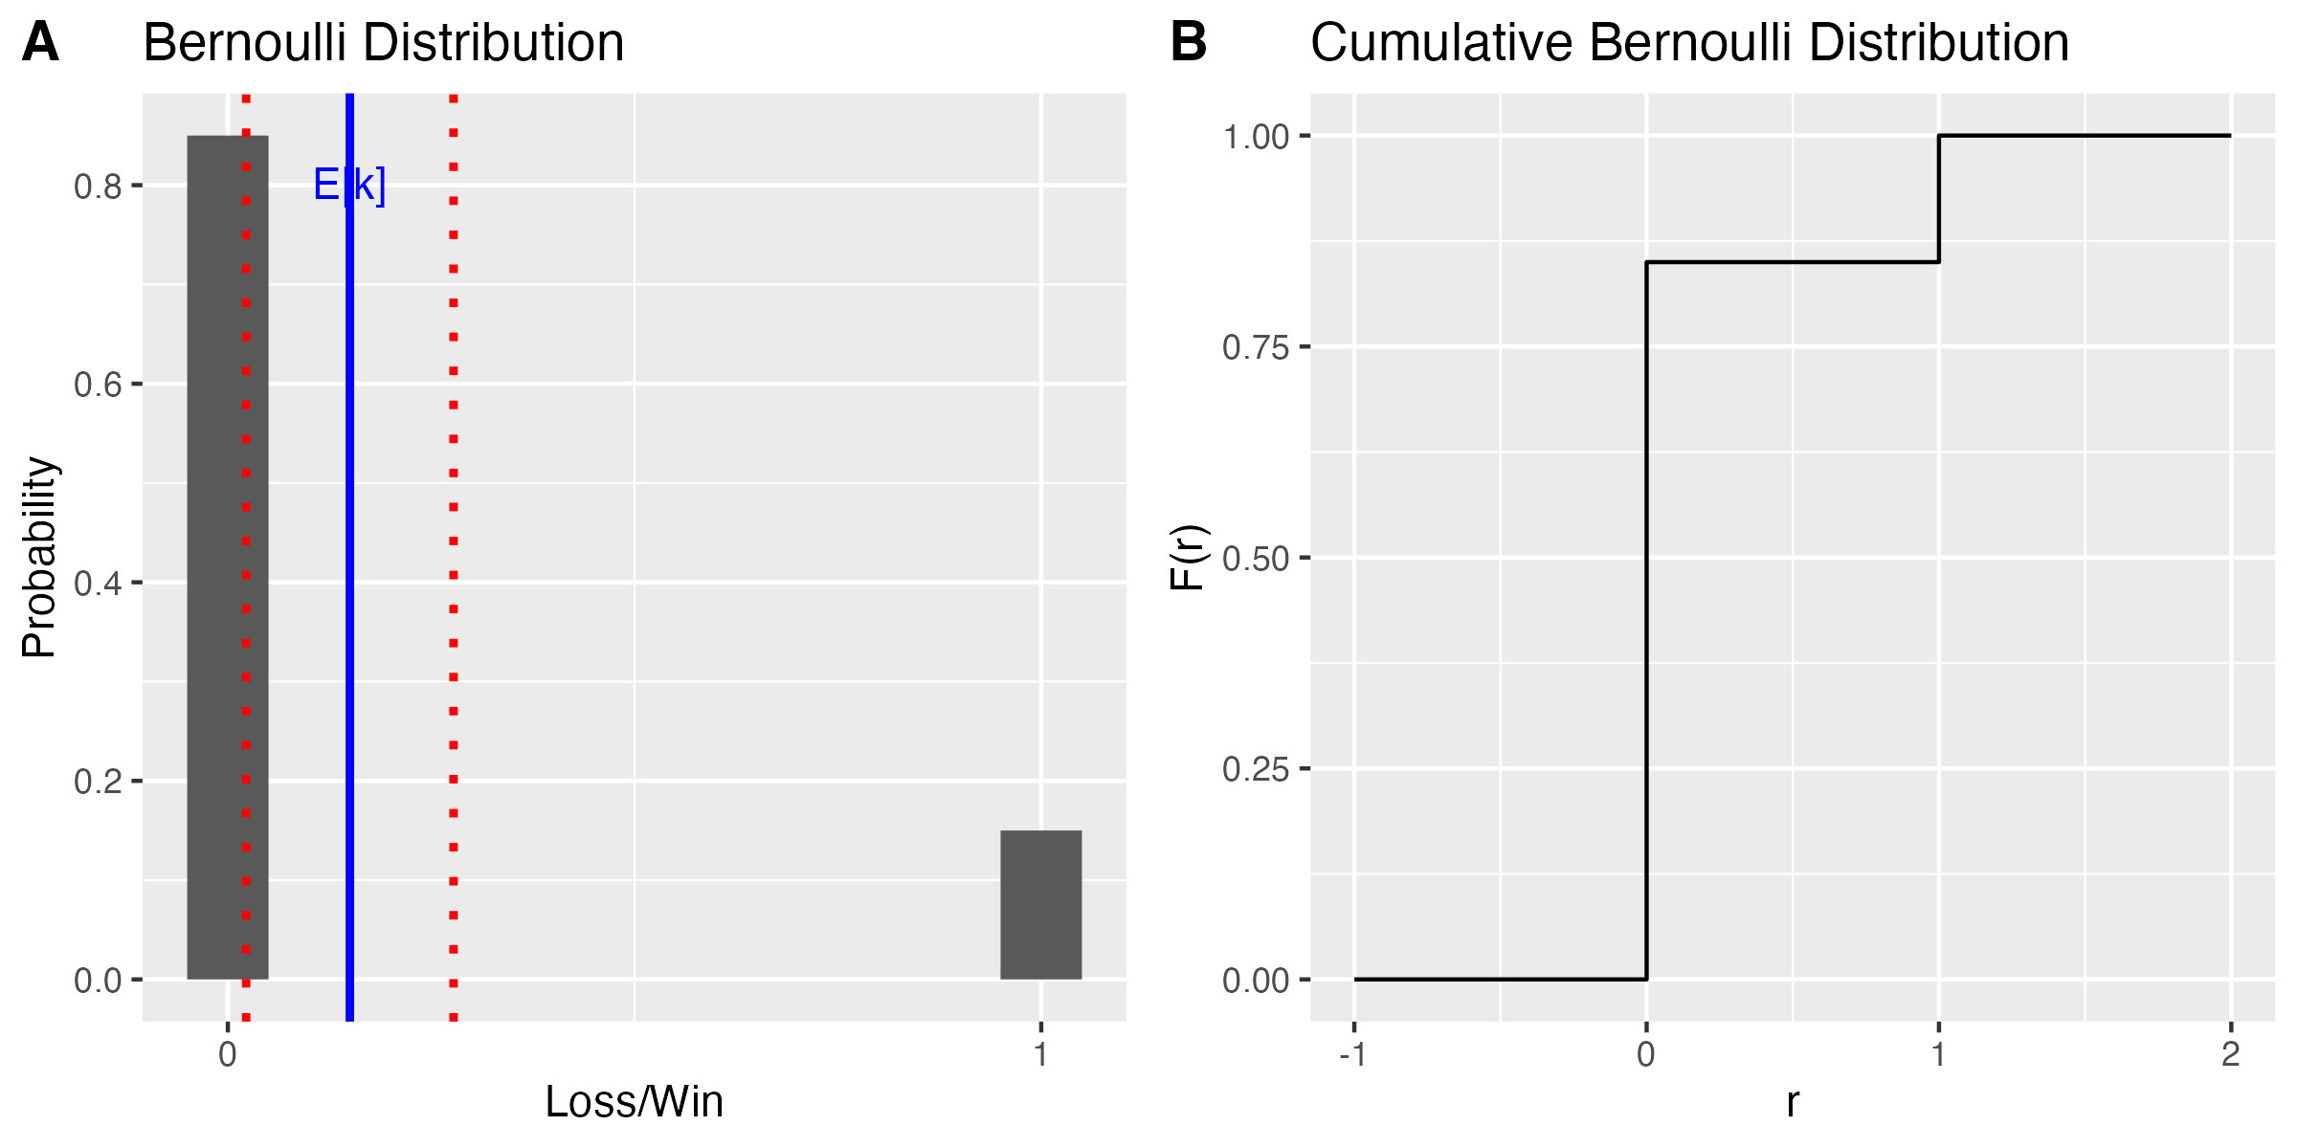
Example Bernoulli Distribution
E[X]=0.15
Var[X]=0.125

Slide 8
Features of a Bernoulli Experiment
There are two possible outcomes arbitrary called success and failure
A success occurs with probability p and a failure occurs with probability q=1-p
The Random Variable is ordered as 1 if success and 0 if failure

Slide 9
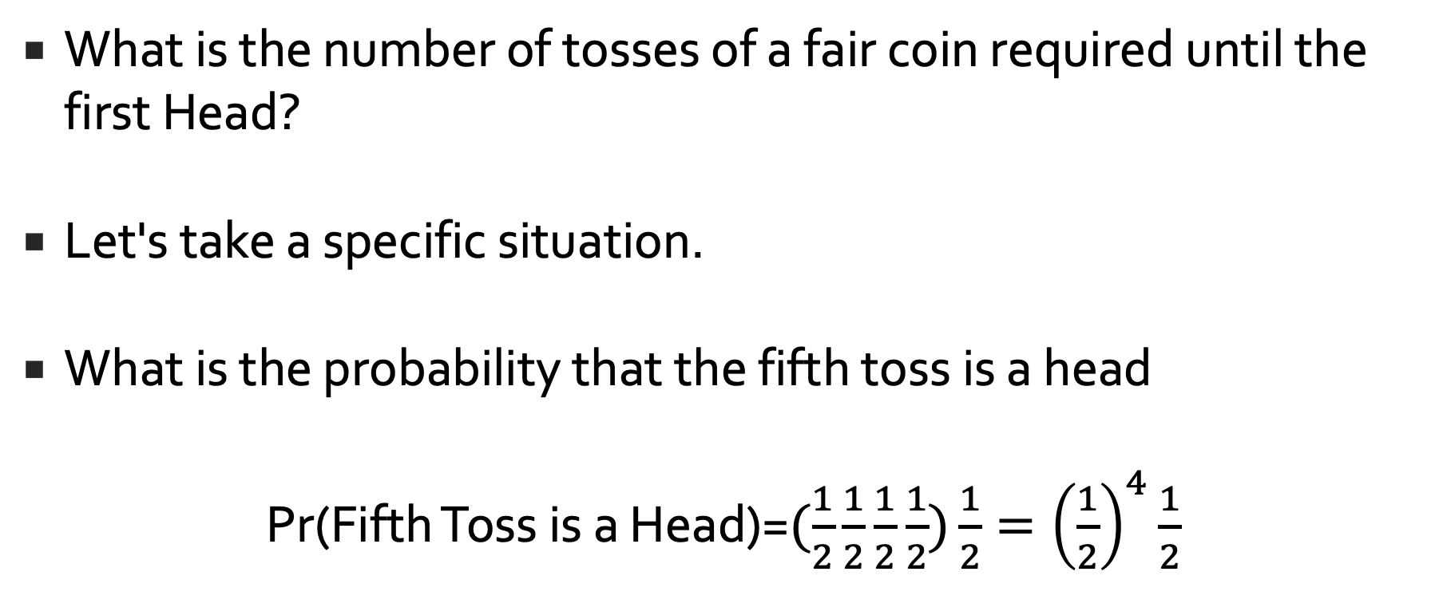

Bernoulli Process
What is the number of tosses of a fair coin required until the first Head?
Let's take a specific situation.
What is the probability that the fifth toss is a head
Pr(Fifth Toss is a Head)=$(\frac{1}{2}\frac{1}{2}\frac{1}{2}\frac{1}{2})\frac{1}{2}={\left(\frac{1}{2}\right)}^{4}\frac{1}{2}$
https://onlinecourses.science.psu.edu/stat414/node/76

Slide 10
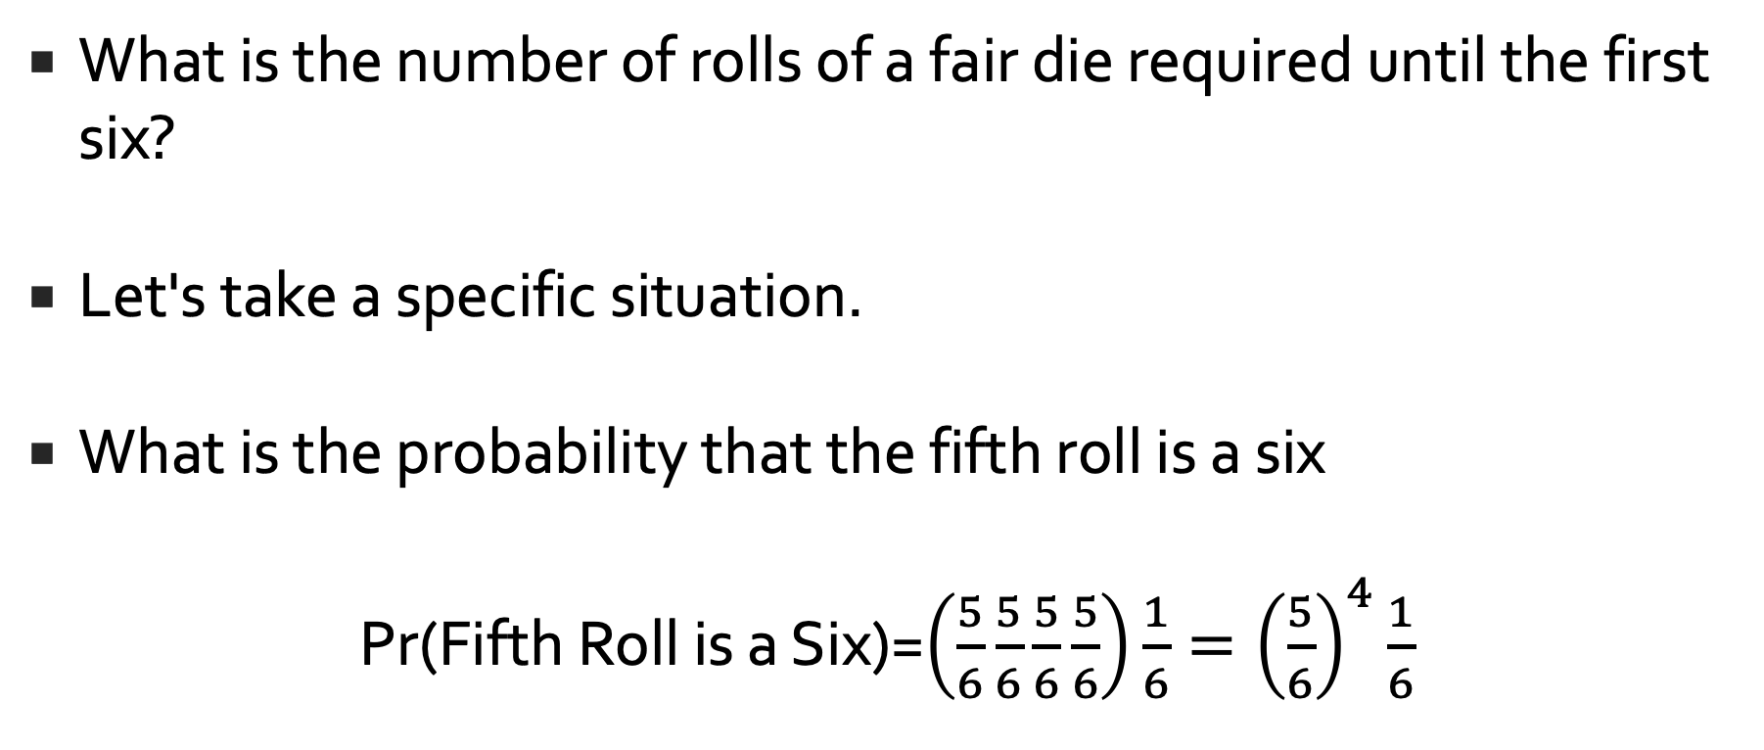
Bernoulli Process
What is the number of rolls of a fair die required until the first six?
Let's take a specific situation.
What is the probability that the fifth roll is a six
Pr(Fifth Roll is a Six)=$\left(\frac{5}{6}\frac{5}{6}\frac{5}{6}\frac{5}{6}\right)\frac{1}{6}={\left(\frac{5}{6}\right)}^{4}\frac{1}{6}$
https://onlinecourses.science.psu.edu/stat414/node/76

Slide 11
Geometric Distribution

Slide 12

Geometric Distribution
I play until I win

Slide 13

Geometric Distribution
Pr(X=x) $=p\left(x\right)=q^{x−1}p=$(${1−p)}^{x−1}p$
$$x=1,2,3,…,∞, 0<p<1$$
This is the probability mass function for a geometric distribution

Slide 14
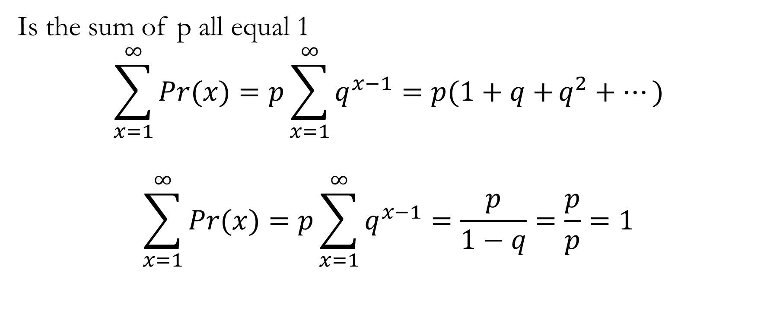
Geometric Distribution
Is the sum of p all equal 1
$$\sum_{x=1}^{∞}{Pr(x)}=p\sum_{x=1}^{∞}{q^{x−1}=p(1+q+}q^{2}+…)$$
$$\sum_{x=1}^{∞}{Pr(x)}=p\sum_{x=1}^{∞}{q^{x−1}=\frac{p}{1−q}=\frac{p}{p}=1}$$

Slide 15
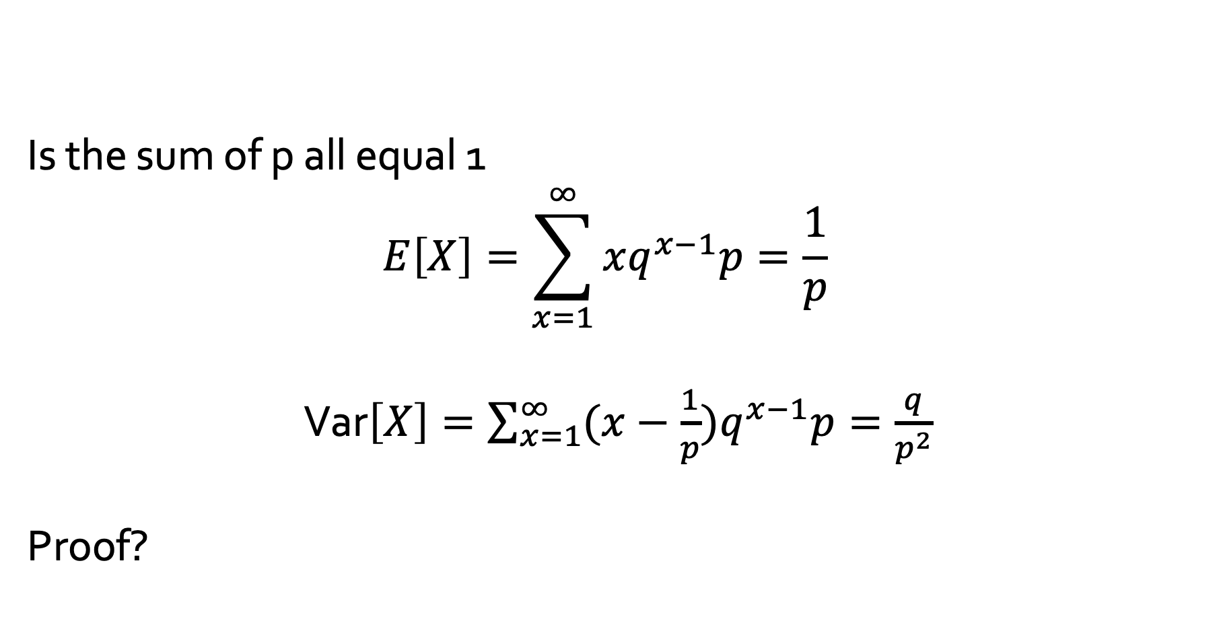
Geometric Distribution
Is the sum of p all equal 1
$$E\left[X\right]=\sum_{x=1}^{∞}{xq^{x−1}p}=\frac{1}{p}$$
Var$\left[X\right]=\sum_{x=1}^{∞}{(x−\frac{1}{p})q^{x−1}p}=\frac{q}{p^{2}}$
Proof?

Slide 16

Coin Game
Toss a coin until you get a Tails

Slide 17
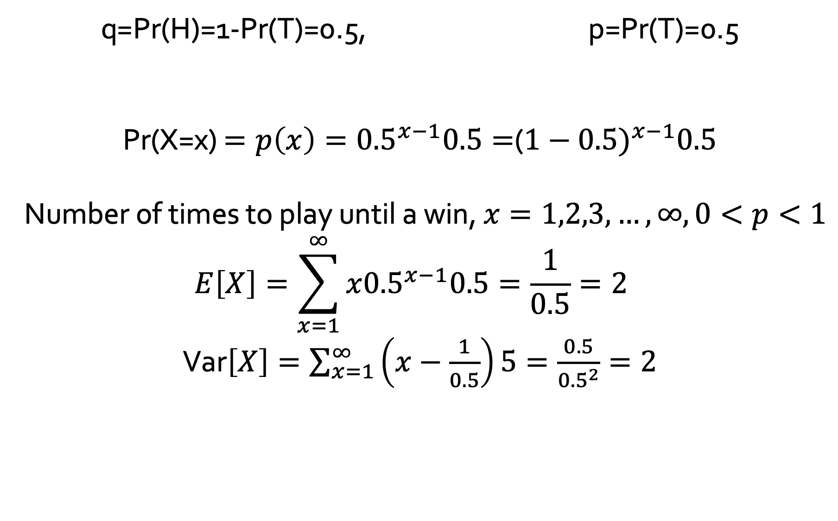
Coin Toss - Geometric Distribution
q=Pr(H)=1-Pr(T)=0.5, p=Pr(T)=0.5
Pr(X=x) $=p\left(x\right)={0.5}^{x−1}0.5=$(${1−0.5)}^{x−1}0.5$
Number of times to play until a win, $x=1,2,3,…,∞, 0<p<1$
$$E\left[X\right]=\sum_{x=1}^{∞}{x{0.5}^{x−1}0.5}=\frac{1}{0.5}=2$$
Var$\left[X\right]=\sum_{x=1}^{∞}{\left(x−\frac{1}{0.5}\right)5}=\frac{0.5}{{0.5}^{2}}=2$

Slide 18
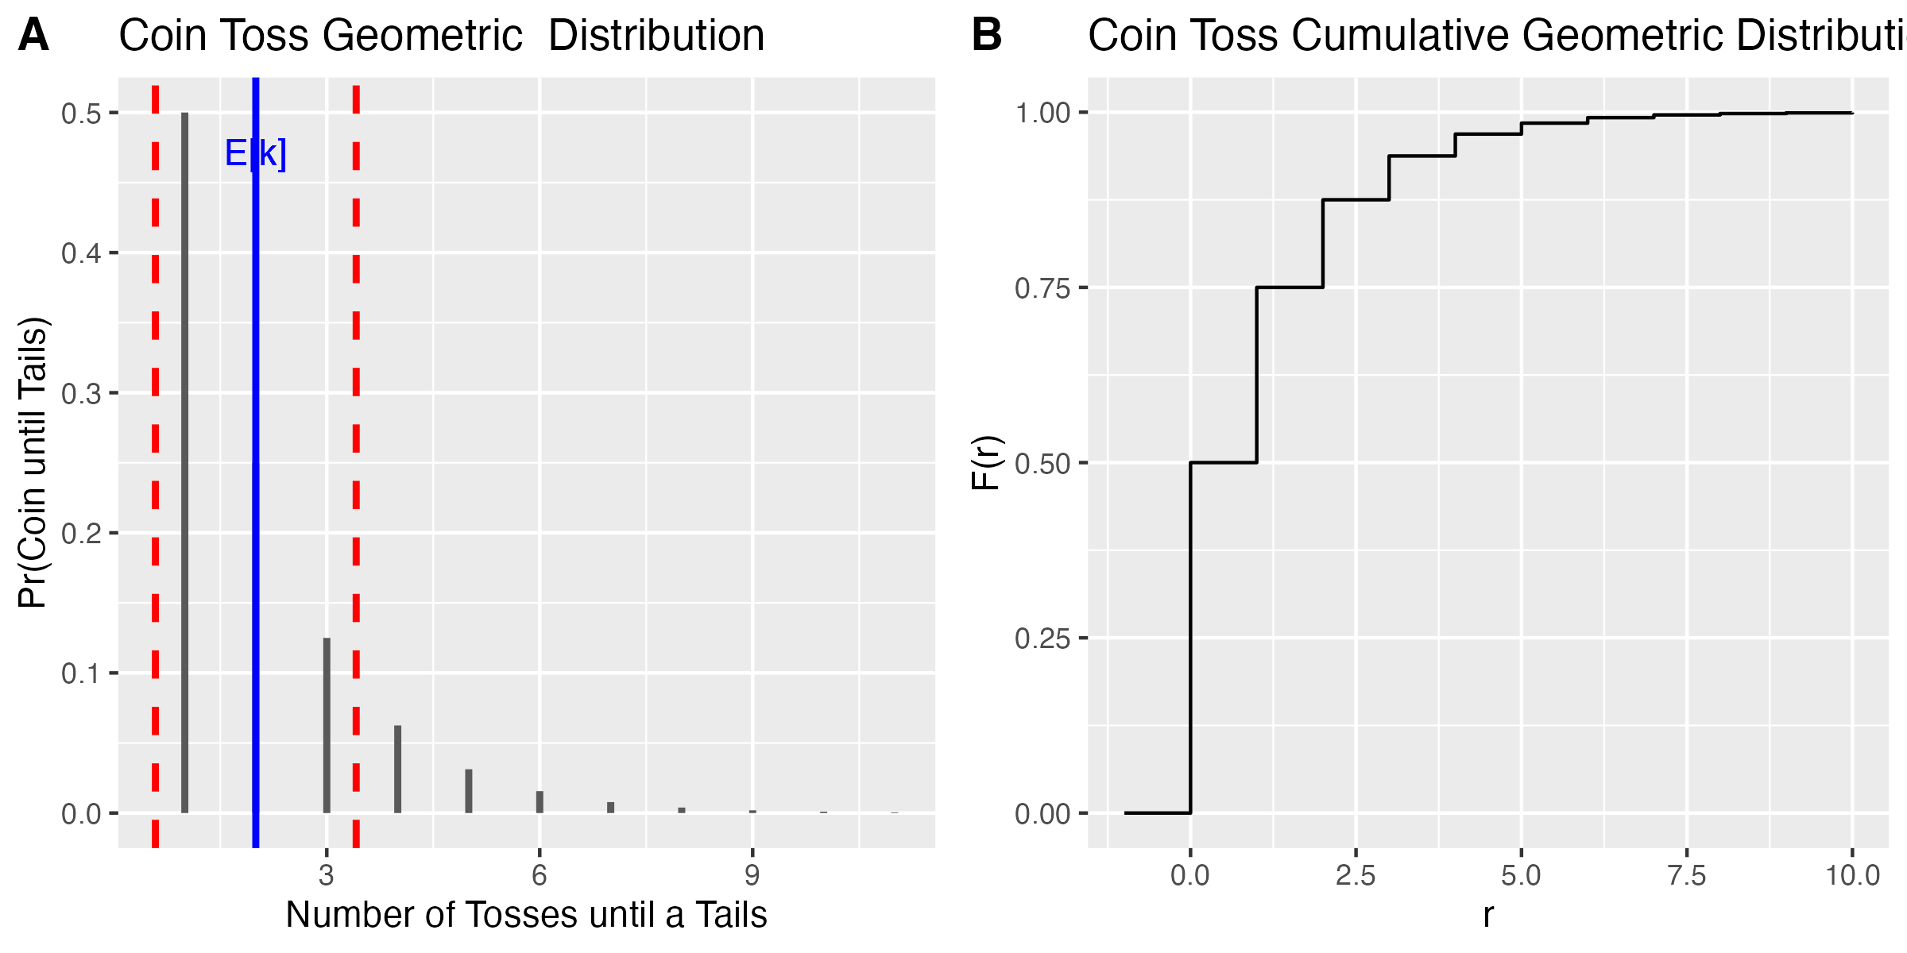
Coin Toss - Probability MASS Function

Slide 19

Coin Toss - Cumulative Distribution

Slide 20
Coin Toss

Slide 21
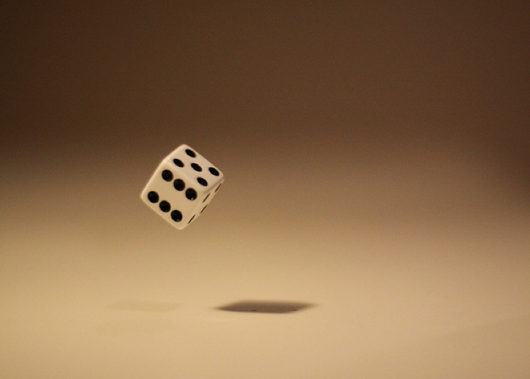
Dice Game
Roll Dice until you get a 6

Slide 22
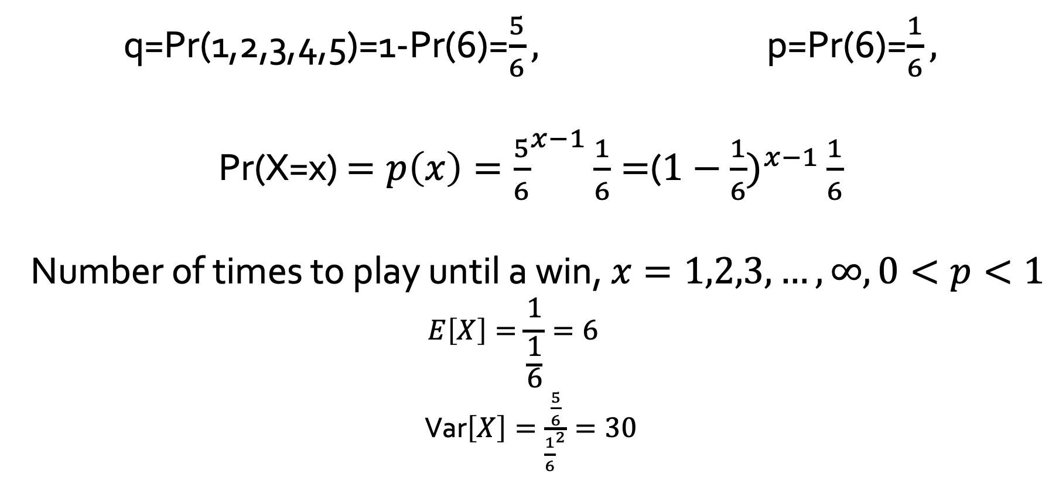
Dice Game-Geometric Distribution
q=Pr(1,2,3,4,5)=1-Pr(6)=$\frac{5}{6},$ p=Pr(6)=$\frac{1}{6},$
Pr(X=x) $=p\left(x\right)={\frac{5}{6}}^{x−1}\frac{1}{6}=$(${1−\frac{1}{6})}^{x−1}\frac{1}{6}$
Number of times to play until a win, $x=1,2,3,…,∞, 0<p<1$
$$E\left[X\right]=\frac{1}{\frac{1}{6}}=6$$
Var$\left[X\right]=\frac{\frac{5}{6}}{{\frac{1}{6}}^{2}}=30$

Slide 23
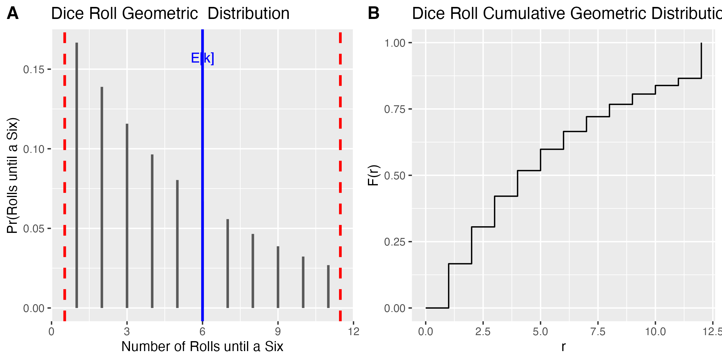
First Six - Probability Mass Distribution

Slide 24
First Six -Cumulative Distribution

Slide 25
First Six
Probability Mass Function
Cumulative Distribution

Slide 26
Note about Notation
X ~ G(p)
P is the probability
In R
dgeom(x, prob, log = FALSE): returns the value of the geometric probability density function Note x starts a 0.
pgeom(q, prob, lower.tail = TRUE, log.p = FALSE): returns the value of the geometric cumulative density function.
qgeom(p, prob, lower.tail = TRUE, log.p = FALSE): returns the value of the inverse geometric cumulative density function.
rgeom(n, prob): generates a vector of geometric distributed random variables.

Slide 27
Rugby - Ireland vs New Zealand

Slide 28

Ireland vs New Zealand
The probability of Ireland beating New Zealand in a one off game is 0.15.
Describe the geometric distribution if Ireland played New Zealand until Ireland wins.

Slide 29
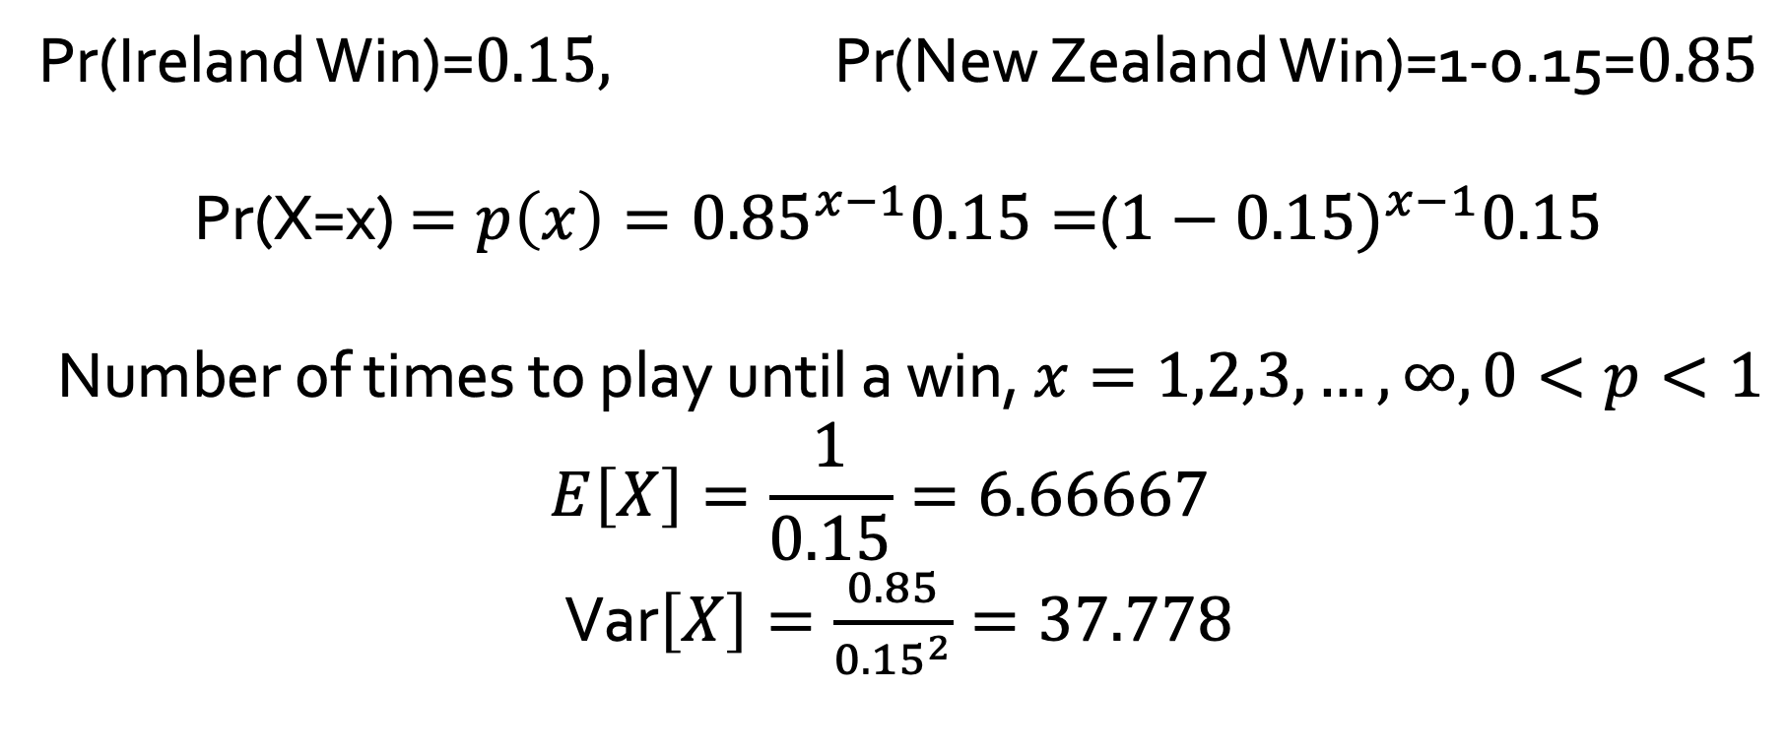
Ireland vs New Zealand
Pr(Ireland Win)=$0.15,$ Pr(New Zealand Win)=1-0.15=$0.85$
Pr(X=x) $=p\left(x\right)={0.85}^{x−1}0.15=$(${1−0.15)}^{x−1}0.15$
Number of times to play until a win, $x=1,2,3,…,∞, 0<p<1$
$$E\left[X\right]=\frac{1}{0.15}=6.66667$$
Var$\left[X\right]=\frac{0.85}{{0.15}^{2}}=37.778$

Slide 30
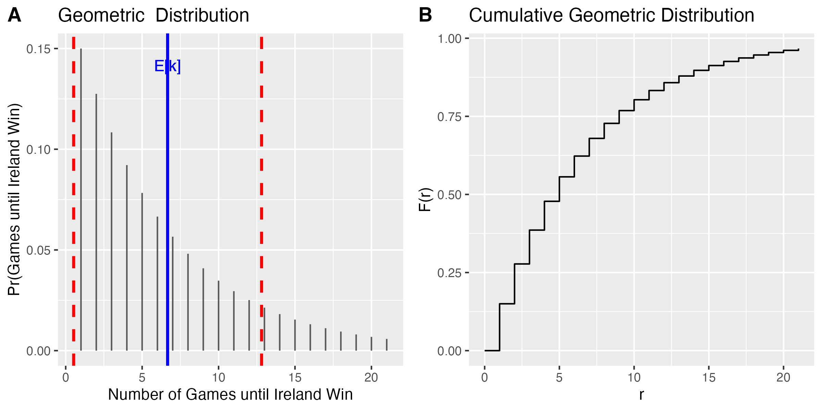
Ireland vs New Zealand

Slide 31
Transmission Error

Slide 32
Example- Transmission Error
One percent of bits transmitted through a digital transmission are received in error. Bits are transmitted until the first error.
Let X denote the number of bits transmitted until the first error.

Slide 33
Product Error

Slide 34
Example - Product Error
It is known that 5% of smart phones on a production line are defective. Products are inspected until the first defective smart phone is encountered
Let X number of inspections to obtain first defective

Slide 35
Example 2 - Product Error

Slide 36
Example 2 - Product Error
You go to the Factory and for 10 days you test until you find a defective product
Day | 1 | 2 | 3 | 4 | 5 | 6 | 7 | 8 | 9 | 10
Freq of fault | 15 | 13 | 16 | 14 | 11 | 7 | 9 | 6 | 5 | 4
Do you believe the factory has a product error rate of 0.05?

Slide 37
Takeaway Point
Probability distributions allow us to model uncertainty in discrete outcomes.
A Bernoulli trial is a random experiment with exactly two possible outcomes—success or failure—where the probability of success remains constant across trials.
Geometric distributions model binary outcomes and the number of trials until the first success.

